Slide 1
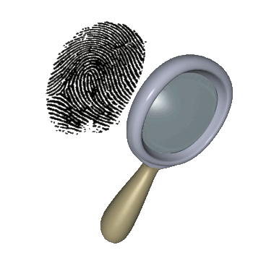
Intro to Fingerprints
“Fingerprints cannot lie,
but liars can make fingerprints.”
—Unknown

Slide 2
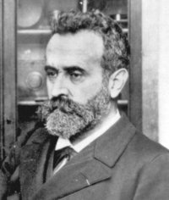
History: Alphonse Bertillon
1883 Created the first systematic system of individual classification & identification
Detailed description of subject, full-length & profile photographs & a system of precise body measurements (anthropometry)

Slide 3
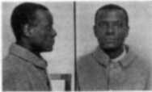
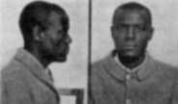
Profile Photos

Slide 4
History: West Brothers
1903 William West was in jail. When they tried to put Will West in prison he was apparently already there….?
Bertillon’s method failed; with fingerprint id taking its place!

Slide 5
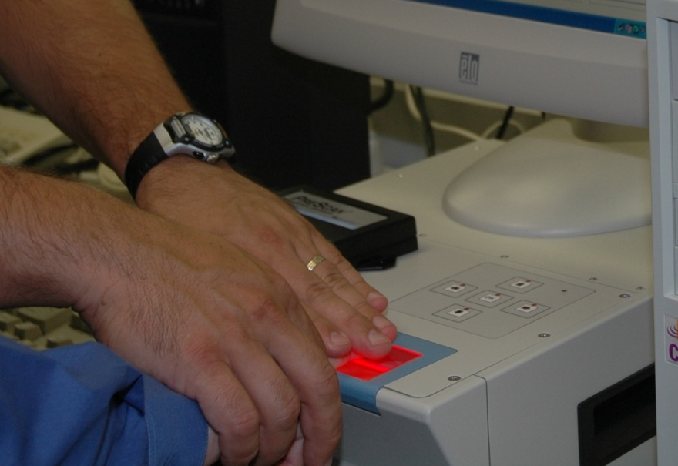
Fingerprints
Students will learn:
Why fingerprints are individual evidence.
Why there may be no fingerprint evidence at a crime scene.
How computers have made personal identification easier.

Slide 6
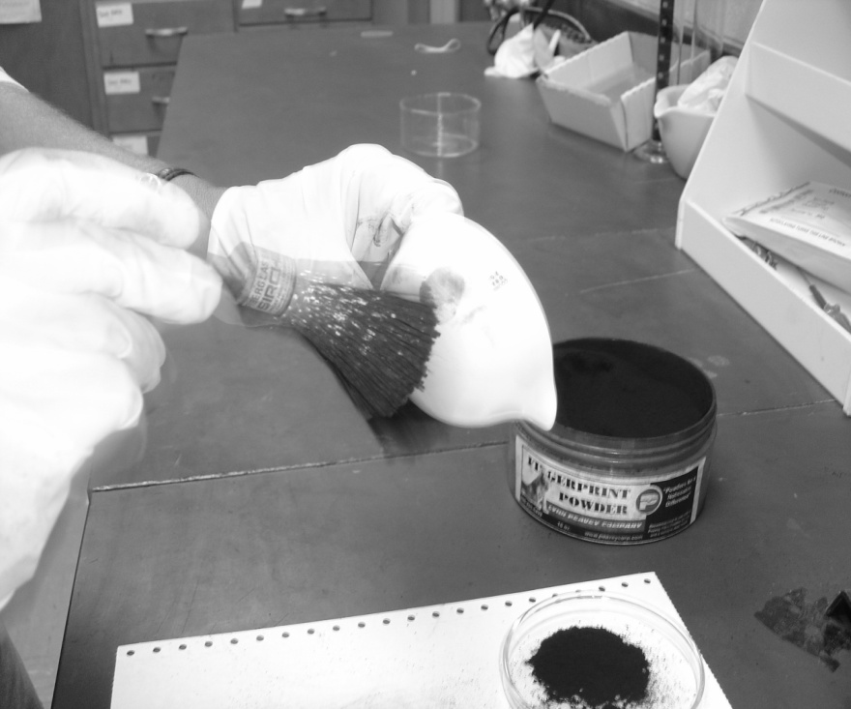
Students will be able to:
Fingerprints
Define the three basic properties that allow individual identification by fingerprints.
Recognize the general ridge patterns (loops, whorls, and arches)
Explain the differences among latent, plastic, and visible fingerprints.

Slide 7
Dactyloscopy -
The study of fingerprints
Historically
  William Herschel —required Indians to put their fingerprints on contracts, and also as a means of identifying prisoners
  Henry Faulds —claimed that fingerprints did not change over time and that they could be classified for identification
  Alphonse Bertillon —proposed body measurements as a means of identification; termed anthropometry
  Francis Galton —developed a primary classification scheme based on loops, arches and whorls.
  Edward Richard Henry —in collaboration with Galton instituted a numerical classification system

Slide 8
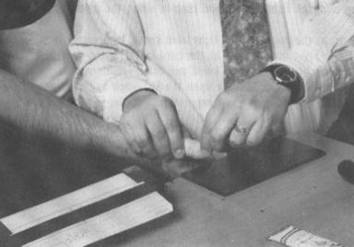
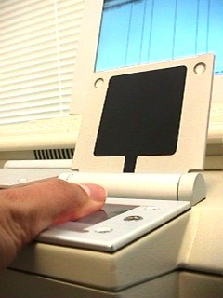
Fingerprints
Recording Prints
  Rolling inked prints - primary identification number
  Live Scan (New technology!)

Slide 9
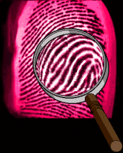
3 Fundamental Principles of Fingerprints
A fingerprint is an individual characteristic. No two people have been found with the exact same fingerprint pattern.
A fingerprint will remain unchanged during an individual’s lifetime.
Fingerprints have general characteristic ridge patterns that permit them to be systematically classified.

Slide 10
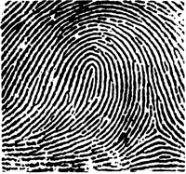
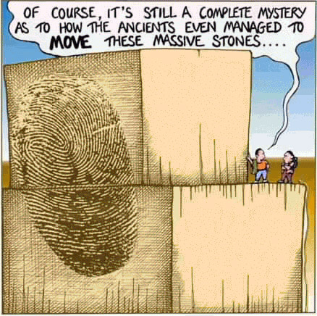
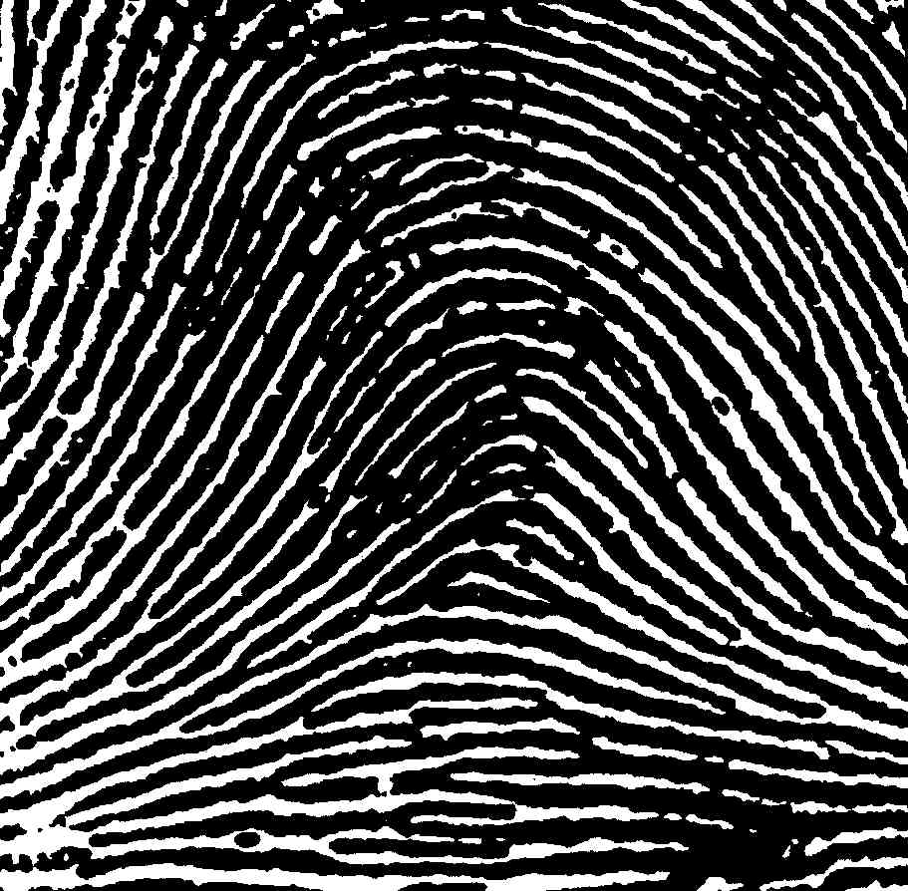
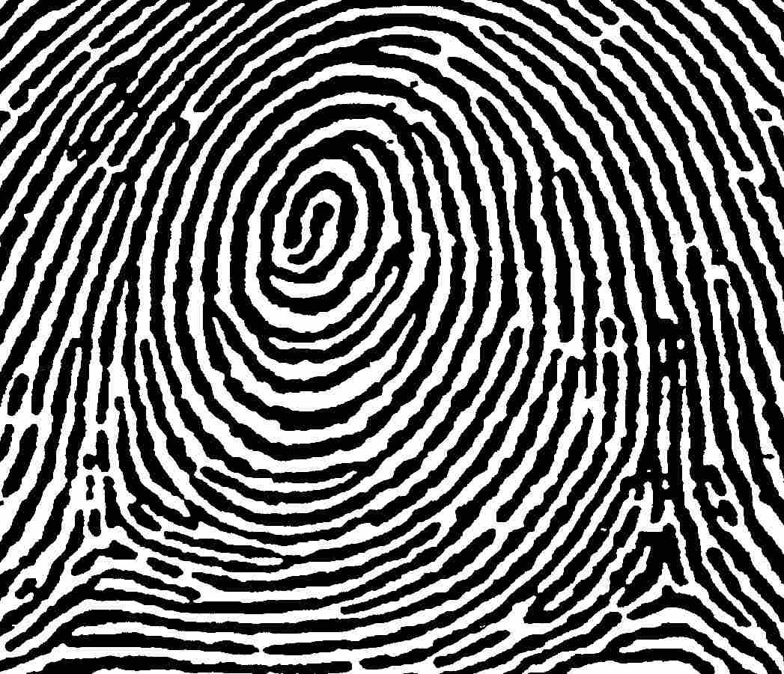
LAW- 3 Main Categories
L
Loops
A
Arches
W
Whorls

Slide 11
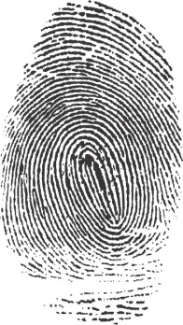
Fingerprint Classes
There are 3 specific classes for all fingerprints based
upon their visual pattern: arches, loops, and whorls.
Each group is divided into smaller groups as seen in the list below.
Arch
Plain arch
Tented arch
Loop
Radial Loop
Ulnar loop
Whorl
Plain whorl
Central pocket loop
Double loop
Accidentical

Slide 12
Based on the activity we did the other day,
Which class do you think is most common?

Slide 13
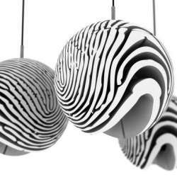
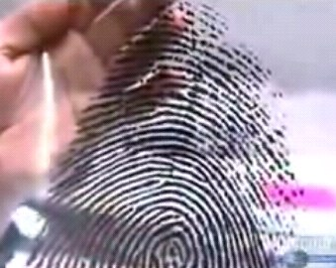
Interesting Info
Fingerprint Statistics:
60% loops,
35% whorls,
5% arches
Did you know?
Police investigators are experts in collecting “dactylograms”, otherwise known as fingerprints.

Slide 14
Gee Whiz Mr. La Magna, What is a Loop?
A loop must have one or more ridges entering and exiting from the same side. Loops must have one delta.
Types
  Radial—opens toward the thumb
  Ulnar—opens toward the “pinky” (little finger)
Which type of loop is this, if it is on the right middle finger? Left middle finger?

Slide 15
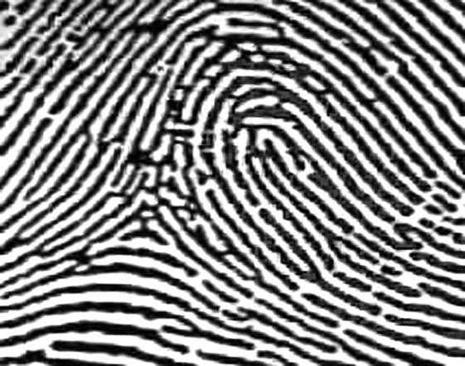
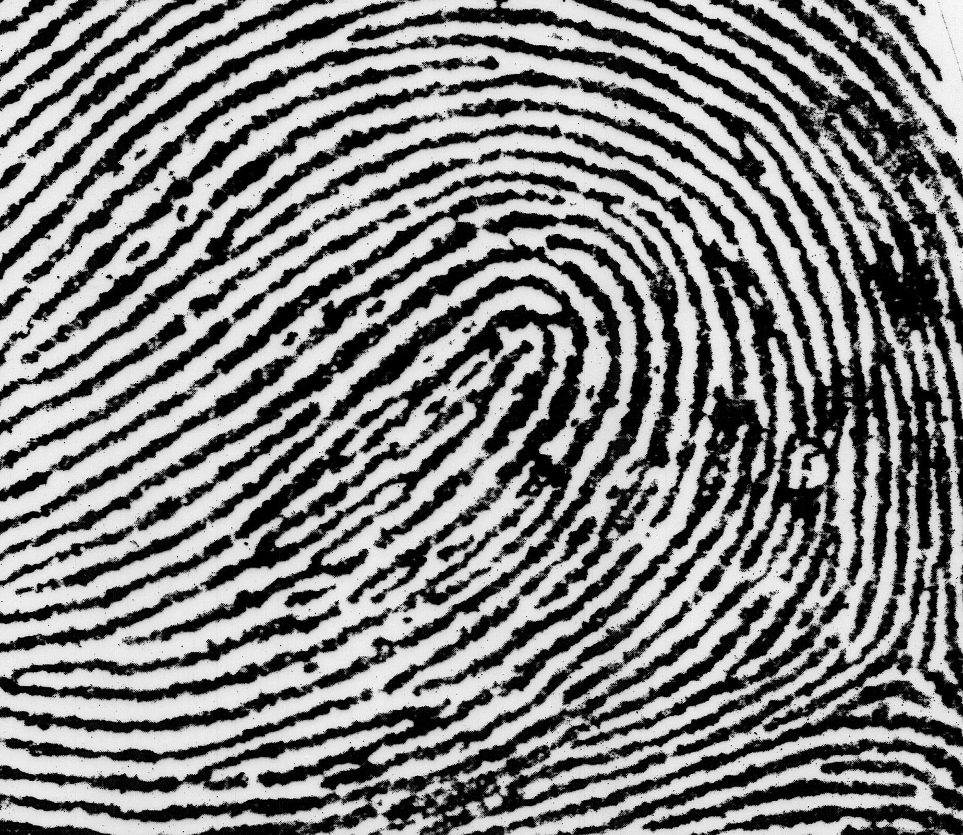
Loops
Loops must have one delta and one or more ridges that enter and leave on the same side. These patterns are named for their positions related to the radius and ulna bones.
Radial Loop (Right Hand)
Loop opens toward the thumb (or radius).
Delta
Ulnar Loop (Right Hand)
Loop opens toward the little finger (or ulna).
Delta

Slide 16
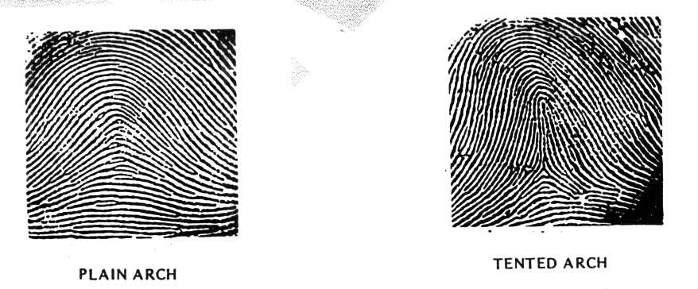
Arch
An arch has friction ridges that enter on one side of the finger and cross to the other side while rising upward in the middle. They do NOT have type lines, deltas, or cores.
Types
  Plain
  Tented

Slide 17
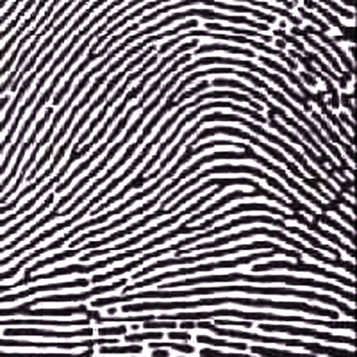
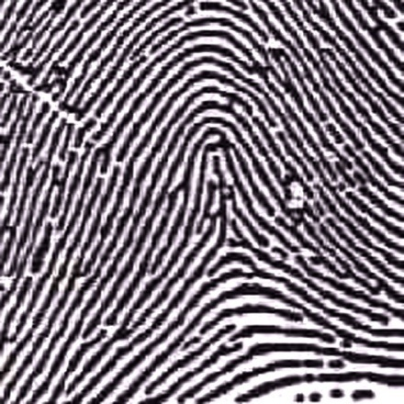
Arches
Arches are the simplest type of fingerprints that are formed by ridges that enter on one side of the print and exit on the other. No deltas are present.
Spike or “tent”
Plain Arch
Ridges enter on one side and
exit on the other side.
Tented Arches
Similar to the plain arch,
but has a spike in the center.

Slide 18
Whorl
A plain or central pocket whorl has at least one ridge that makes a complete circuit. A double loop is made of two loops. An accidental is a pattern not covered by other categories. Whorls have at least two deltas and a core.
Types
  Plain
  Central Pocket
  Double Loop
  Accidental

Slide 19
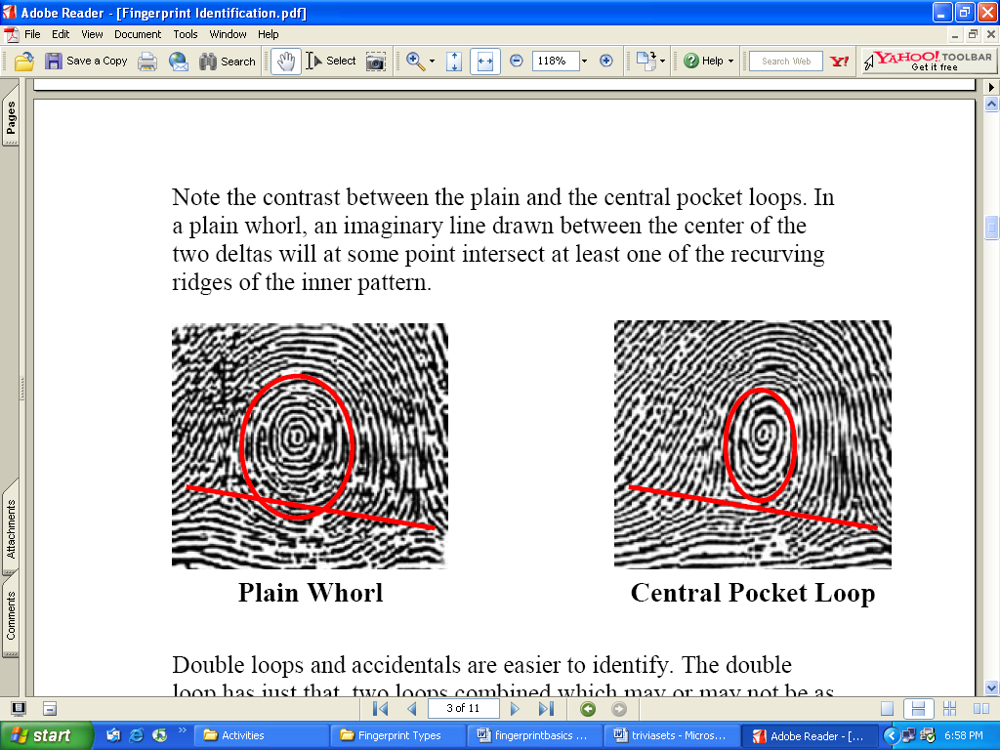
Whorls
Whorls have at least one ridge that makes (or tends to make) a complete circuit. They also have at least two deltas. If a print has more than two deltas, it is most likely an accidental.
Central Pocket Whorl
Plain Whorl
Draw a line between the two deltas in the plain and central pocket whorls. If some of the curved ridges touch the line, it is a plain whorl. If none of the center core touches the line, it is a central pocket whorl.

Slide 20
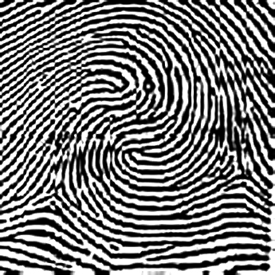
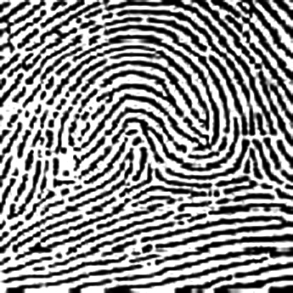
Whorls – Part 2
Double Loop Whorl
Accidental Whorl
Delta
Delta
Double loop whorls are made up of any two loops combined into one print.
Accidental whorls contain two or more patterns (not including the plain arch), or does not clearly fall under any of the other categories.

Slide 21
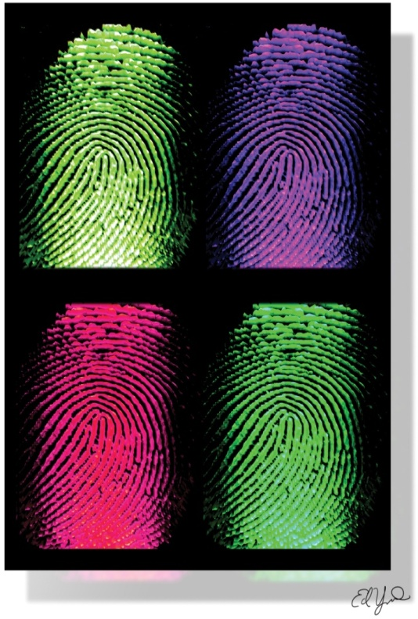
Quick Tips
If a fingerprint has no deltas, it is an arch.
If a fingerprint has one delta, it is a loop.
If a fingerprint has two or more deltas, it is a whorl.

Slide 22
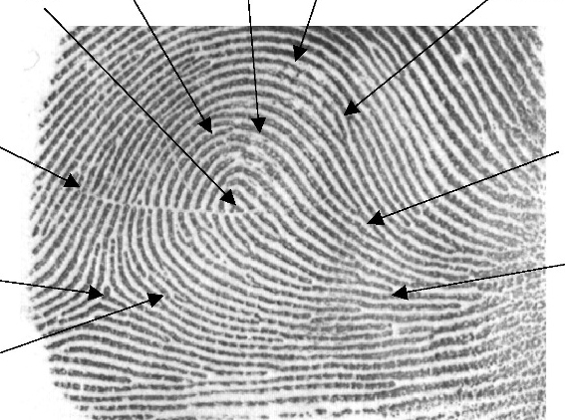
Comparison
There are no legal requirements in the United States on the number of points. Generally, criminal courts will accept 8 to 12 points of similarity.

Slide 23
Latent Prints
Latent fingerprints are those that are not visible to the naked eye. These prints consist of the natural secretions of human skin and require development for them to become visible.
Most secretions come from three glands:
  Eccrine—largely water with both inorganic (ammonia, chlorides, metal ions, phosphates) and organic compounds (amino acids, lactic acids, urea, sugars). Most important for fingerprints.
  Apocrine—secrete pheromones and other organic materials.
  Sebaceous—secrete fatty or greasy substances.

Slide 24
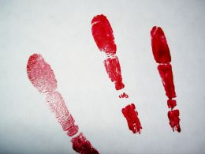
Visible Prints
Prints seen with the naked eye.
Ink, dirt, blood, etc. onto a surface

Slide 25
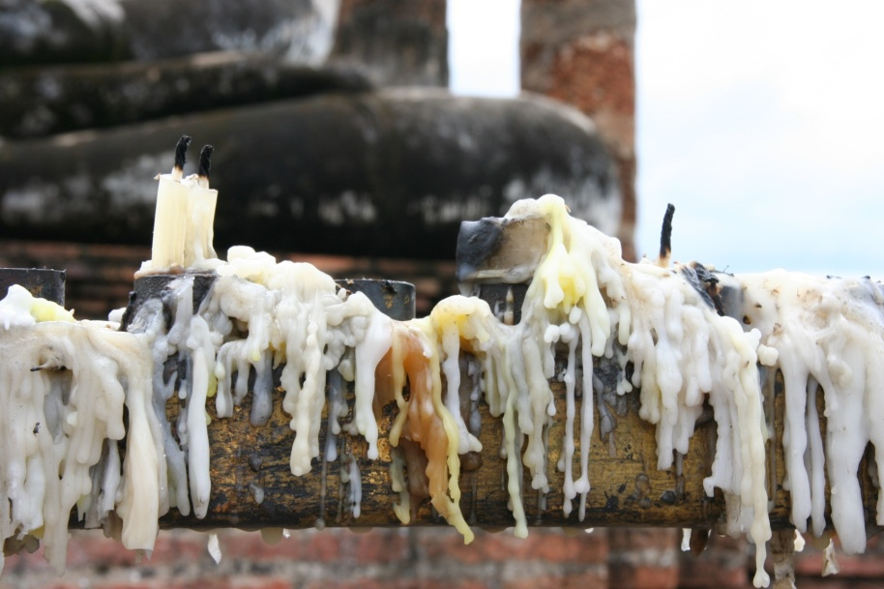
Plastic Prints
Prints left in a soft substance.
Wax, putty, grease deposits, etc.

Slide 26
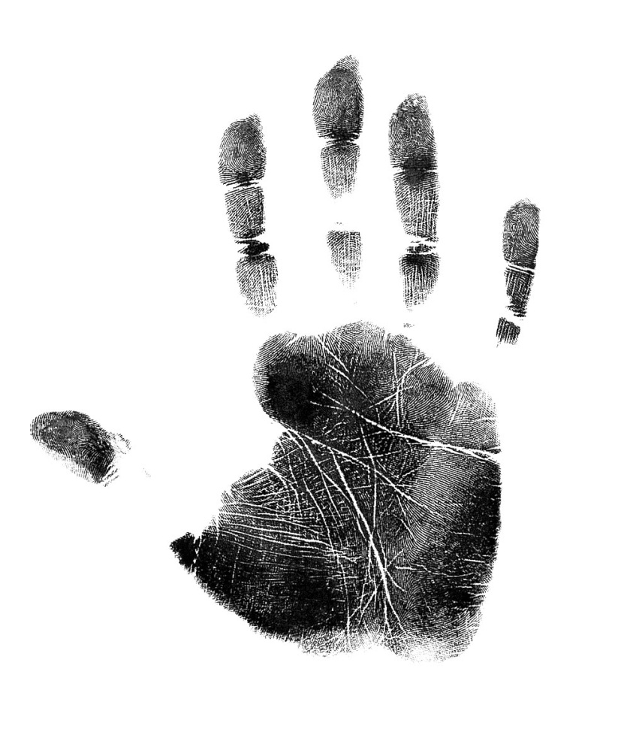
Other Prints
Palm—friction ridges can be identified and may be used against suspects.

Slide 27
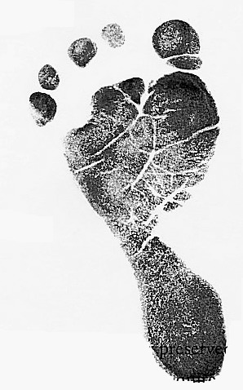
Other Prints
Footprints are taken at birth as a means of identification of infants.

Slide 28
AFIS
The Automated Fingerprint Identification System - a computer system for storing and retrieving fingerprints
Began in the early 1970’s to:
  Search large files for a set of prints taken from an individual
  Compare a single print, usually a latent print developed from a crime scene
By the 1990’s most large jurisdictions had their own system in place. The problem - a person’s fingerprints may be in one AFIS but not in others
IAFIS—the FBI’s Integrated Automated Fingerprint Identification system which is a national database of all 10-print cards from all over the country

Slide 29
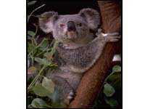
Humans are not the only ones with fingerprints! Some primates, including gorillas and chimpanzees, and koala bears have their own unique prints.
Fingerprints evolved to help koalas improve grip while climbing.

Slide 30
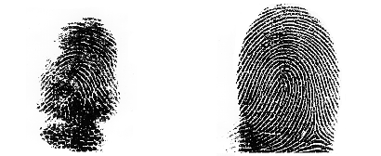
Figure 1. Standard ink prints of fingertips of third right manual digits of an adult koala (left) and an adult
human (right).

Slide 31
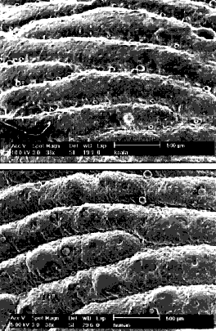
Figure 2. Scanning electron microscope images of epidermis covering fingertips of the same koala (upper) and the same human (lower) as in Figure 1. Slight differences in the texture of epidermal surface may be due to the koala being observed several hours after death, while the human was alive. The scale bar represents 0.5 mm..

Slide 32
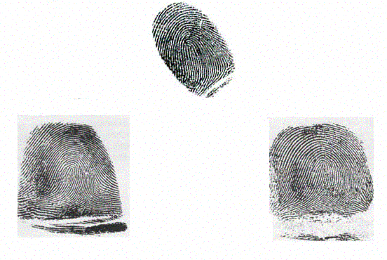
Which print belongs to a… human? chimpanzee? koala bear?

Slide 33
Top = koala
Bottom left =
Human
Bottom right =
Chimp

Slide 34
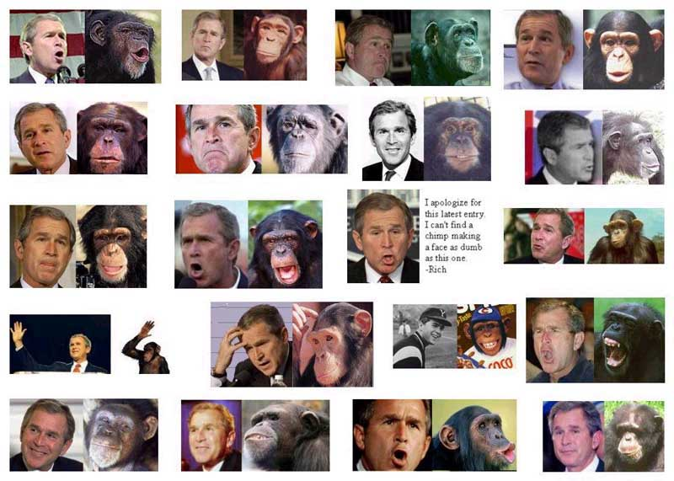

Slide 35
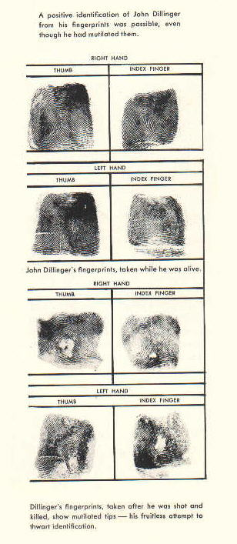
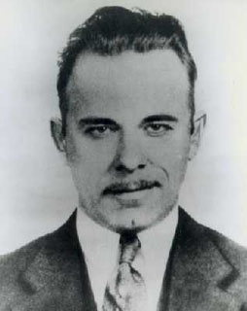
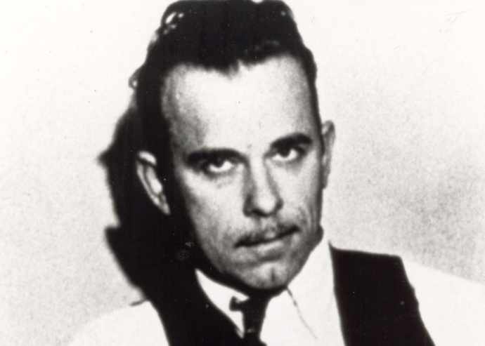
Attempts to Obliterate FP’s
John Dillinger tried to destroy his prints with acid—didn’t work

Slide 36
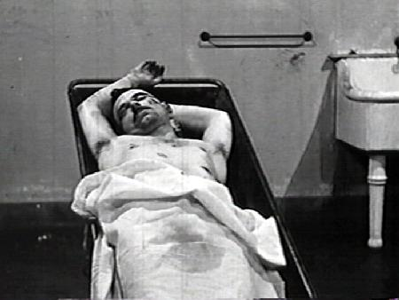

Slide 37
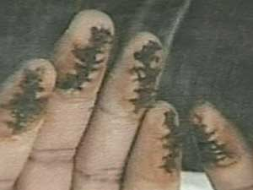
Attempts to Obliterate FP’s
Roscoe Pitts had FP’s surgically removed and skin from rib cage grafted onto fingers—no good
Damage to dermal papillae = a scar
Scar = a new way to ID

